Slide 1
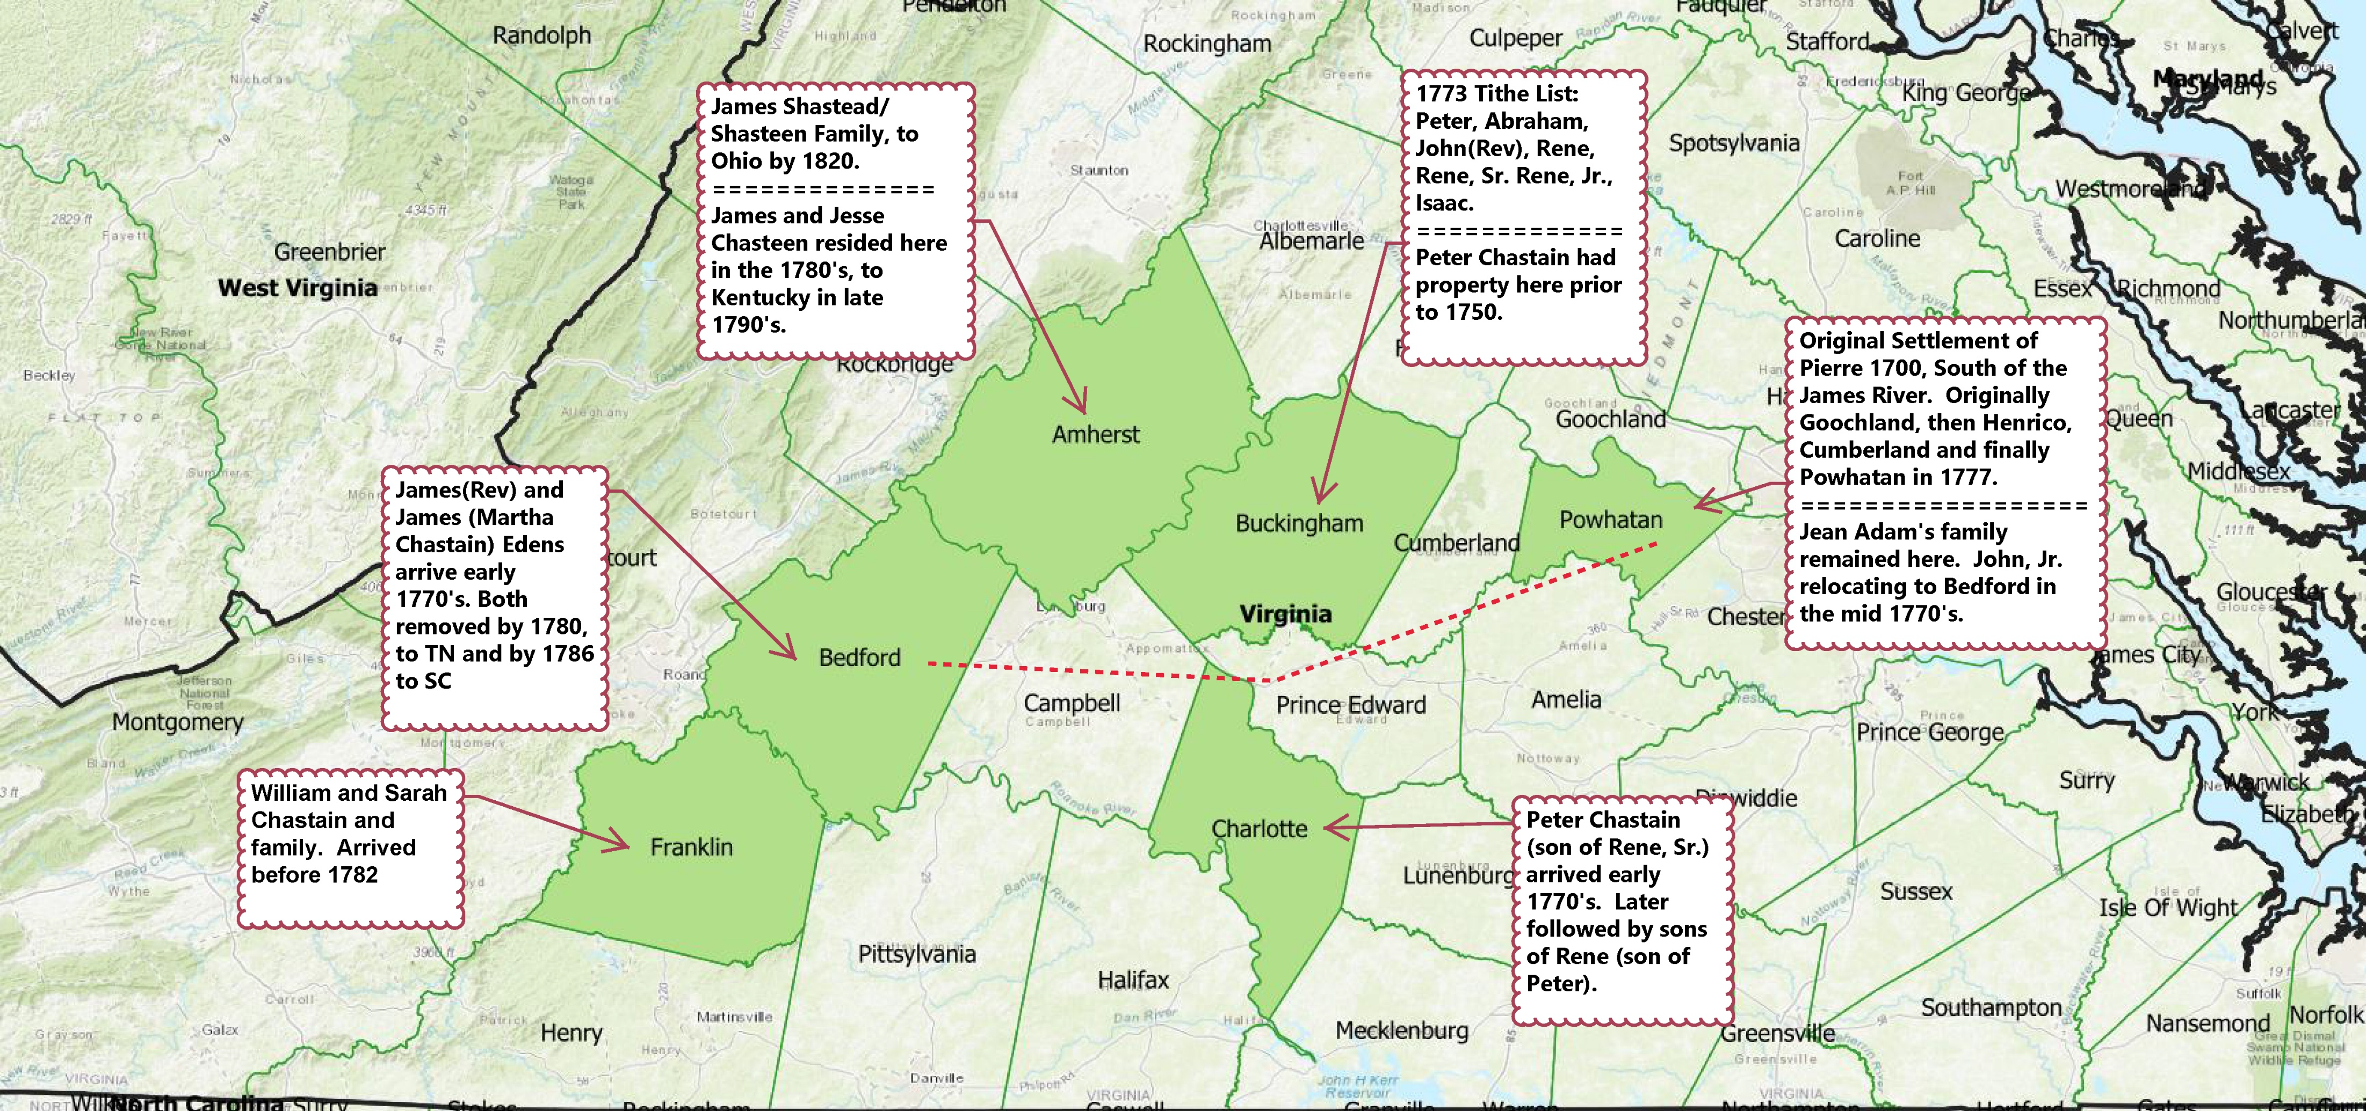
Chastains circa 1770’s
Notes:
Pow-Whatan

Slide 2
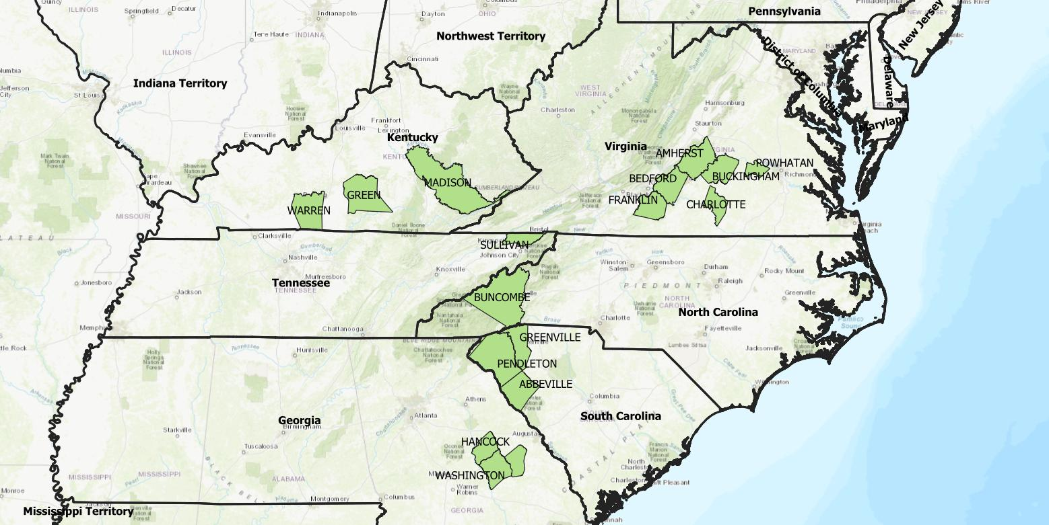
Chastains circa 1780’s to 1800

Slide 3
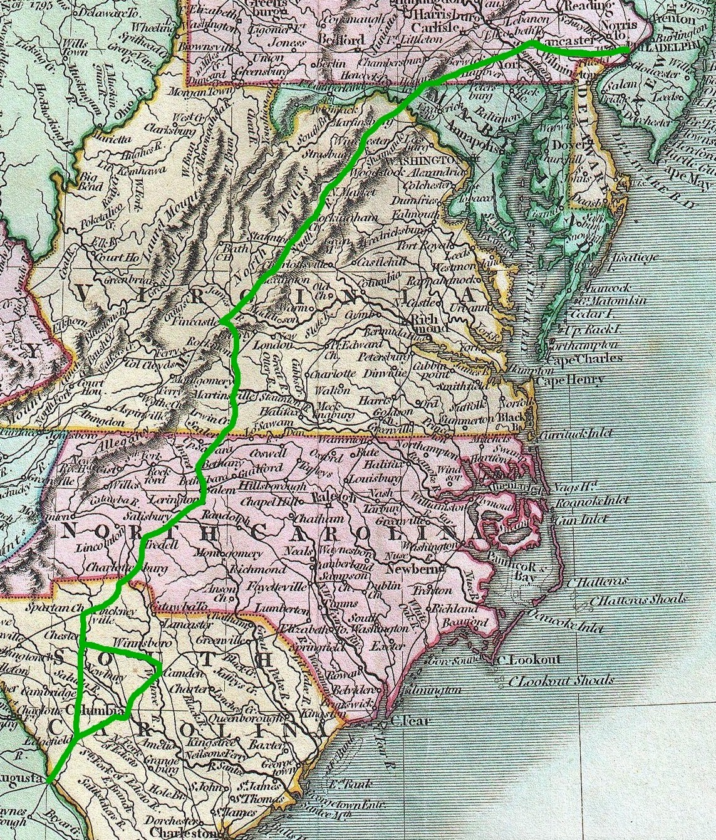
Great Wagon Road
-
Notes:
Virginia Valley Road or Wagon Road

Slide 4
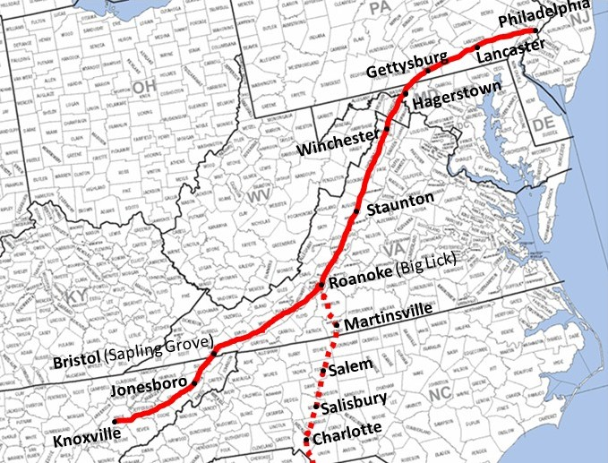
Valley/Wagon Road
-
Notes:
Virginia Valley Road or Wagon Road

Slide 5
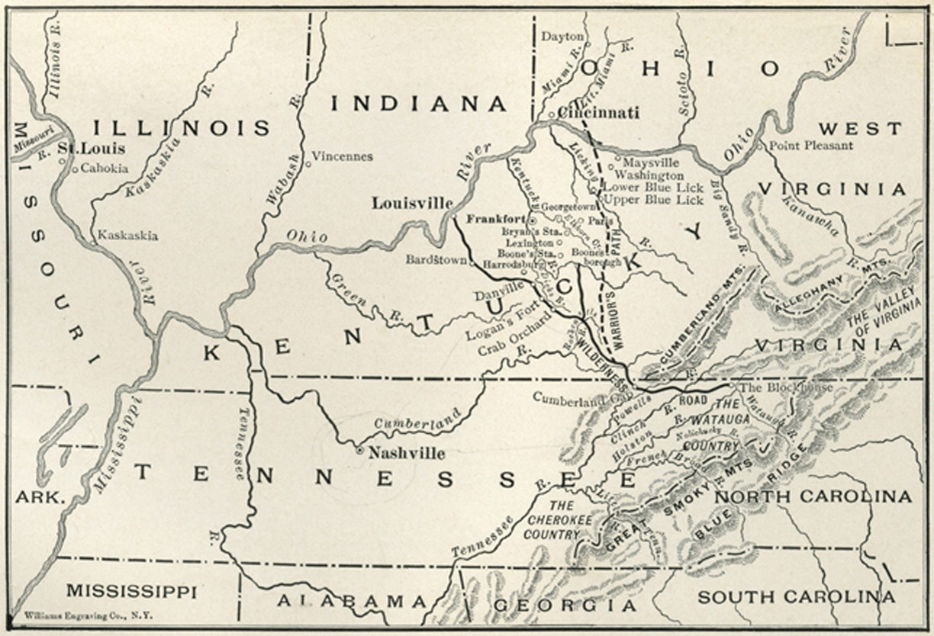
Wilderness/Wagon Road – Cumberland Gap
-
Notes:
Virginia Valley Road or Wagon Road

Slide 6
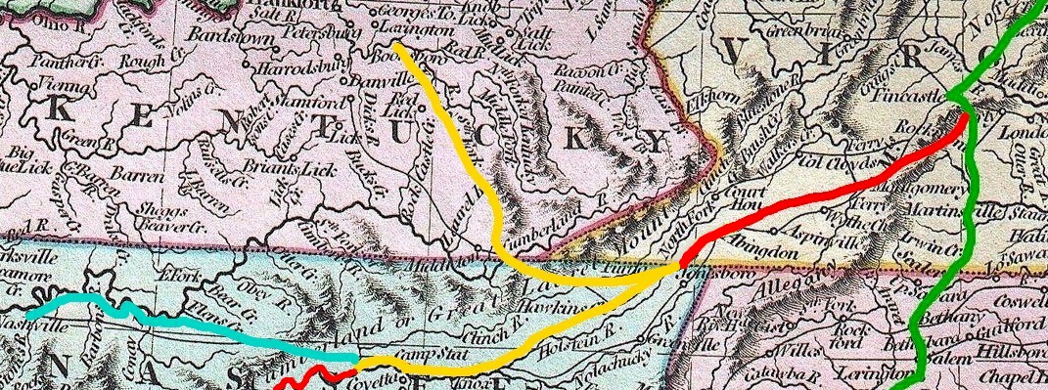
Great Wagon, Valley, Wilderness Roads Detail from Cary’s 1806 Map
Notes:
Virginia Valley Road or Wagon Road

Slide 7
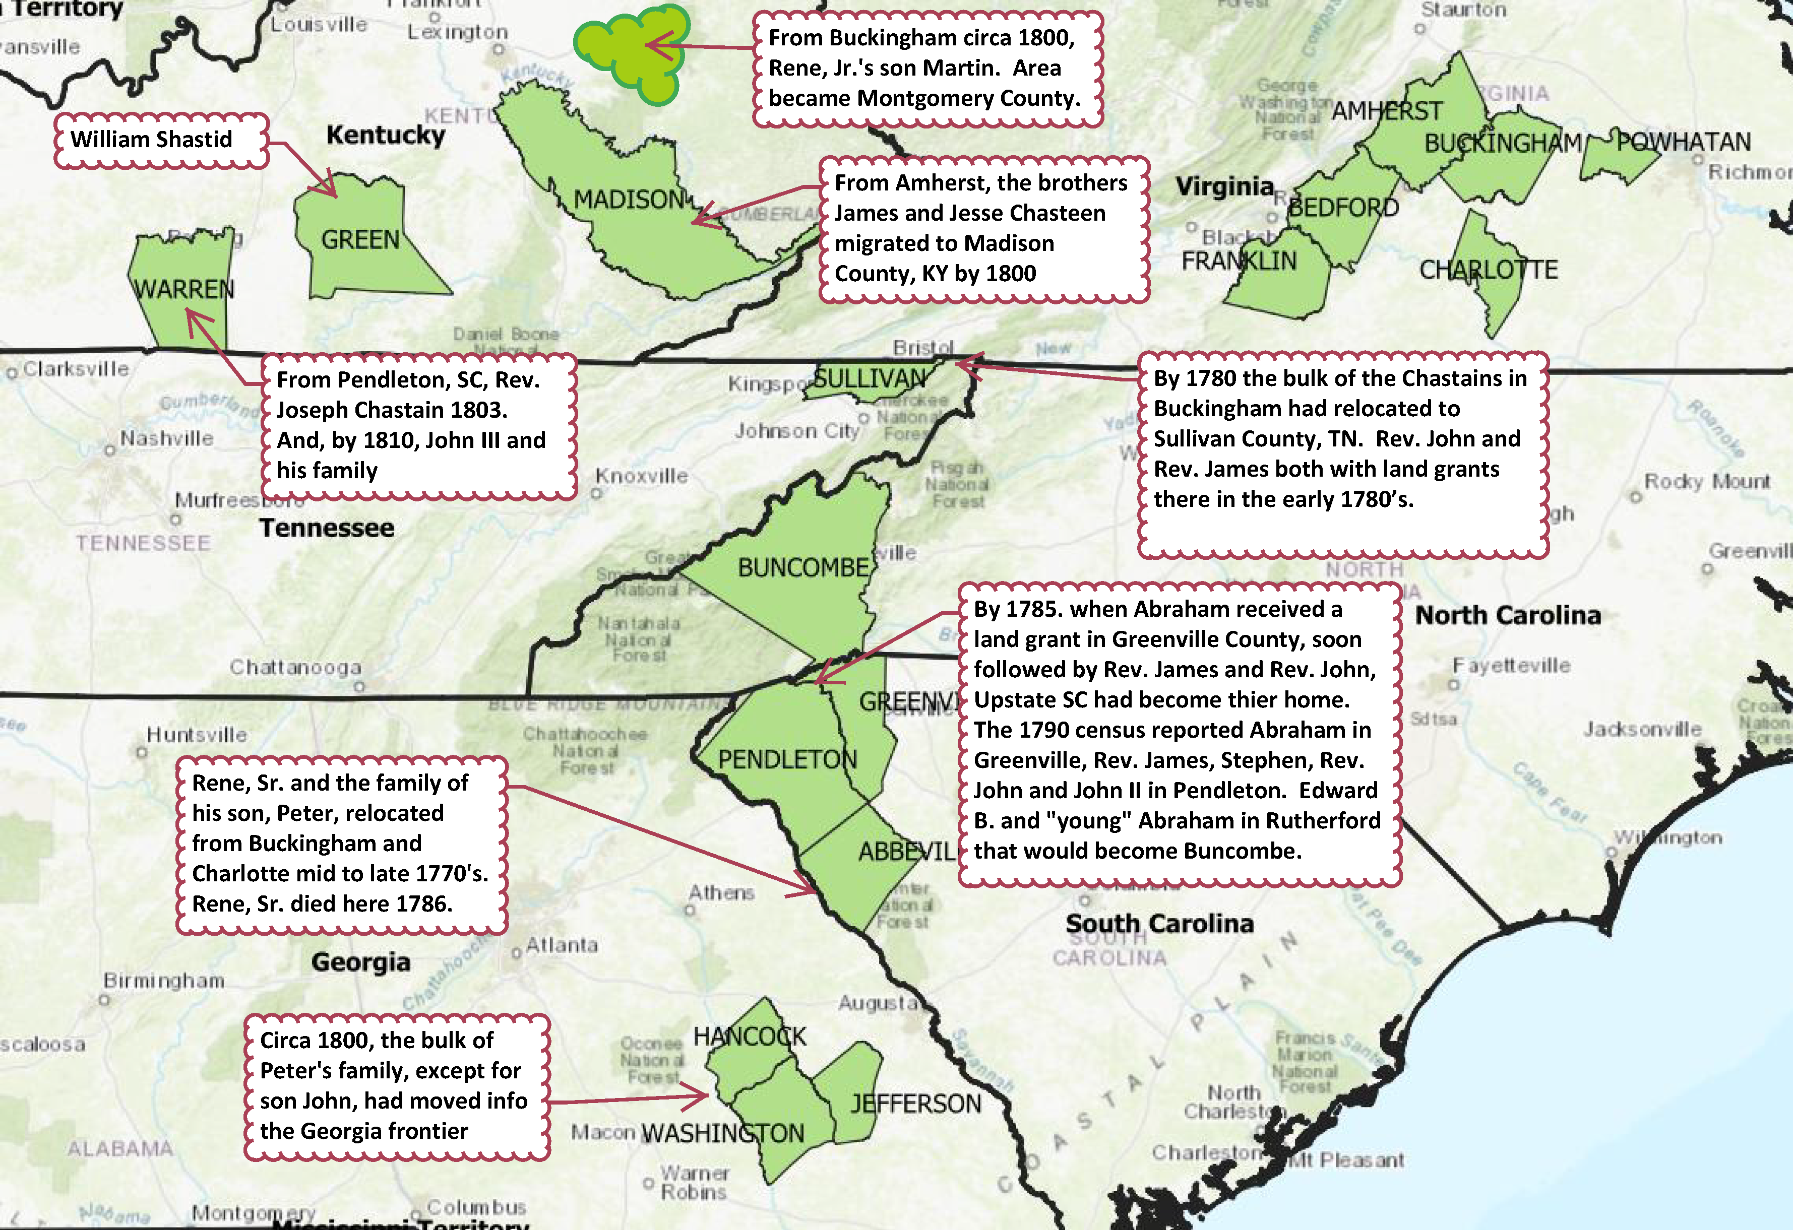
Virginia Chastains circa 1790-1800’s

Slide 8
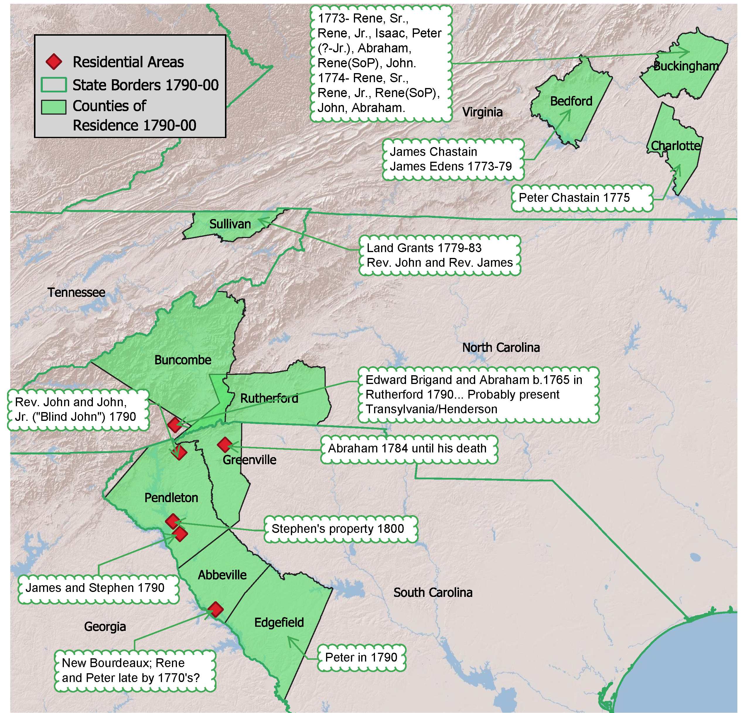
The Chastain Migration to South Carolina
Rene, Sr. and Peter family to Ninety-Six District, SC (Edgefield/Abbeville) after 1775 and prior to 1779.
John and James Chastain, with James (Martha Chastain) Edens had requested land grants in Sullivan County, TN in 1779. Perhaps Abraham was residing with them.
Abraham is the first to request a grant in South Carolina in 1784 in Greenville County. James followed suit in 1785.
By the first census in 1790, Abraham, James, and John were all residing in upstate SC (Pendleton and Greenville).

Slide 9
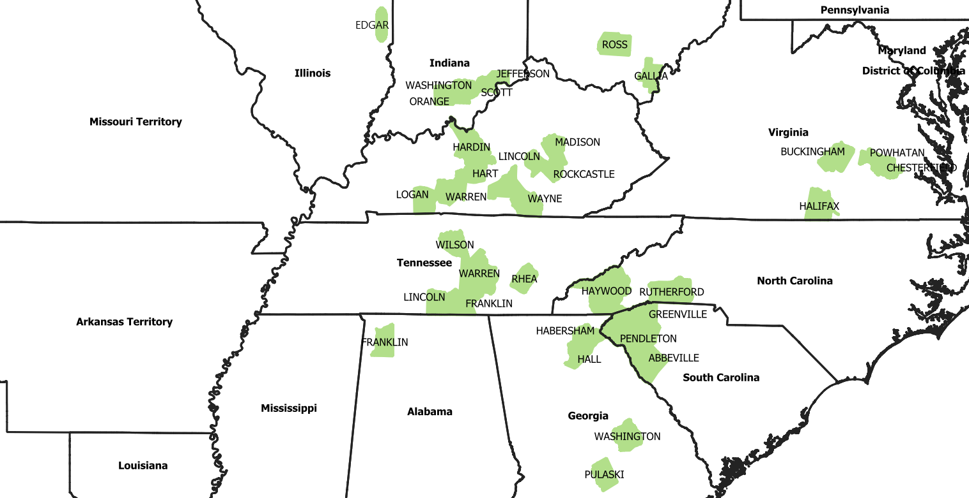
Chastains Circa 1820 (Census & Tax)
-

Slide 10
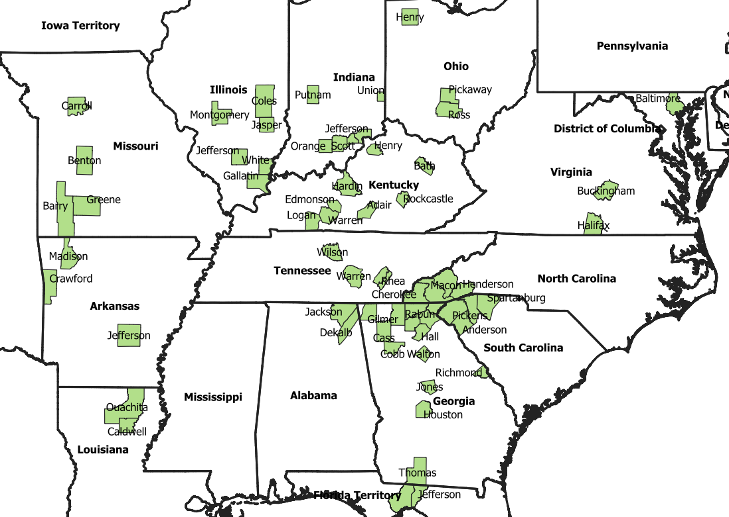
Chastains circa 1840

Slide 11
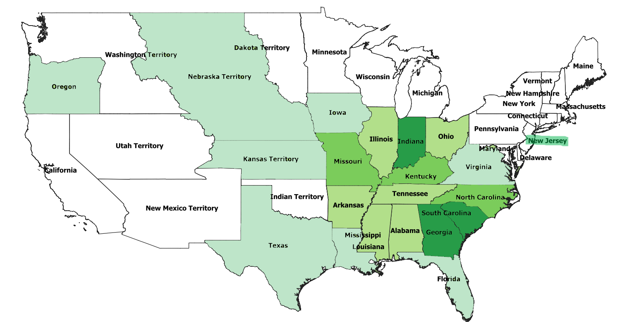
Chastains in the 1850’s

Slide 12
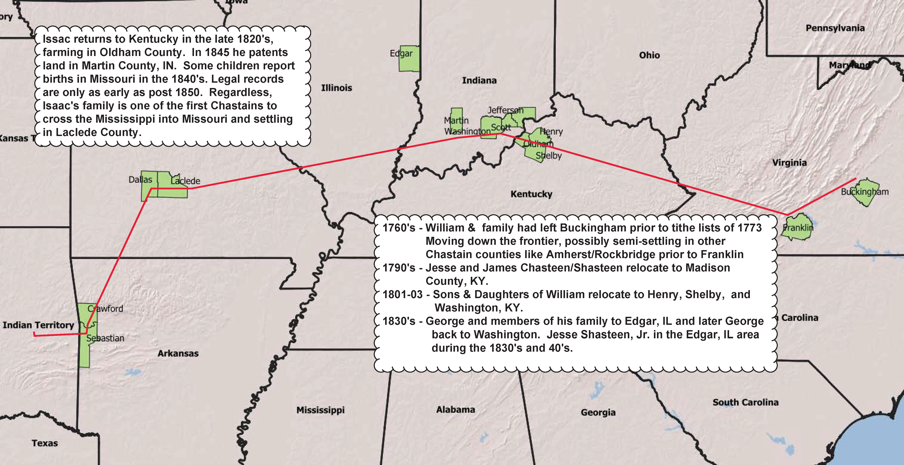
William (Isaac) Chastain’s Migration from Virginia

Slide 13
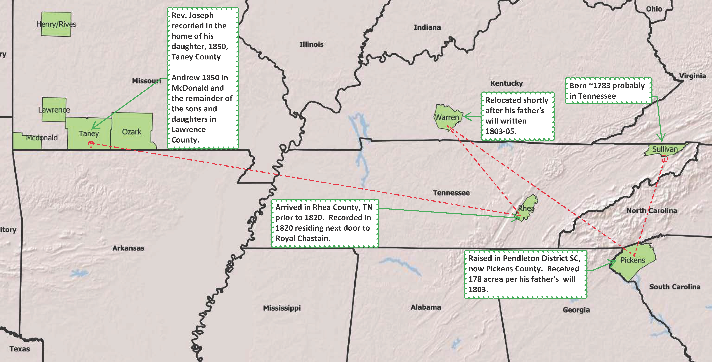
Rev. Joseph Chastain’s Family Migration
-

Slide 14
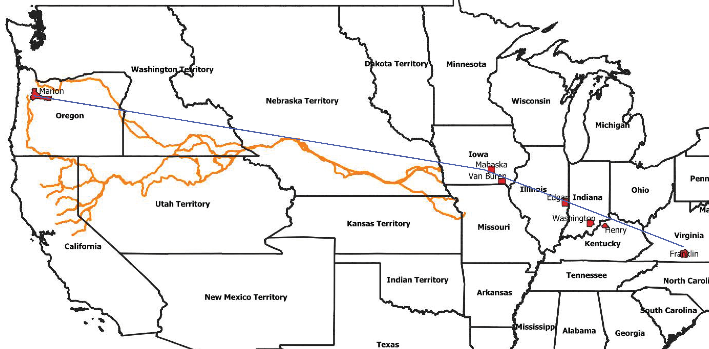
Chastains To The West Coast 1850’s
-
Sarah “Sally” Chastain Bond (George, William, Peter, Pierre)
1797 Born Franklin, VA
1815 Married John Bond in Henry, KY
1821 Washington County, IN
1829 Edgar County, IL
1839 Van Buren, Iowa
1846 Mahaska, Iowa
1852 Joined wagon train at Missouri River in Iowa in May.
1852 Arrived in Oregon in November.

