Slide 1
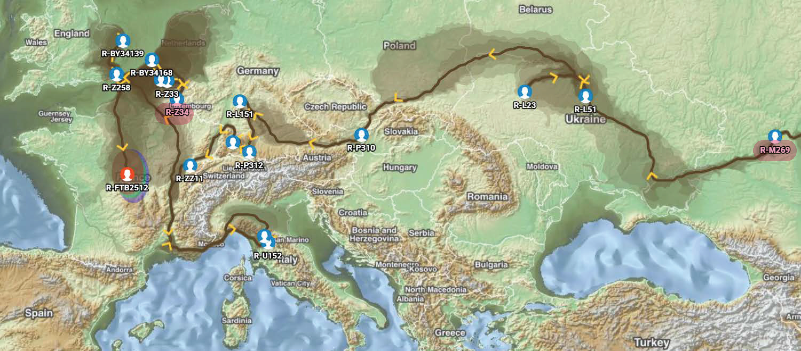
Chastain Y-DNA Project
-
Notes:
Two types of Y-DNA tests, STR (Short Tandem Repeat) and SNP (Single Nucleotide Polymorphism). STR tests are the y37-y111, good entry level tests that determine genetic relationship. The SNP test on the other hand offers a genetic path back in time and

Slide 2
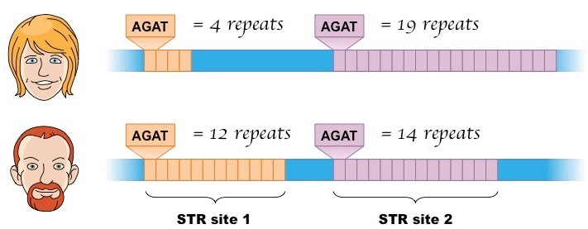
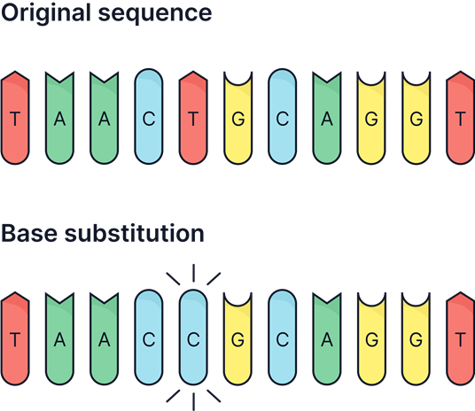
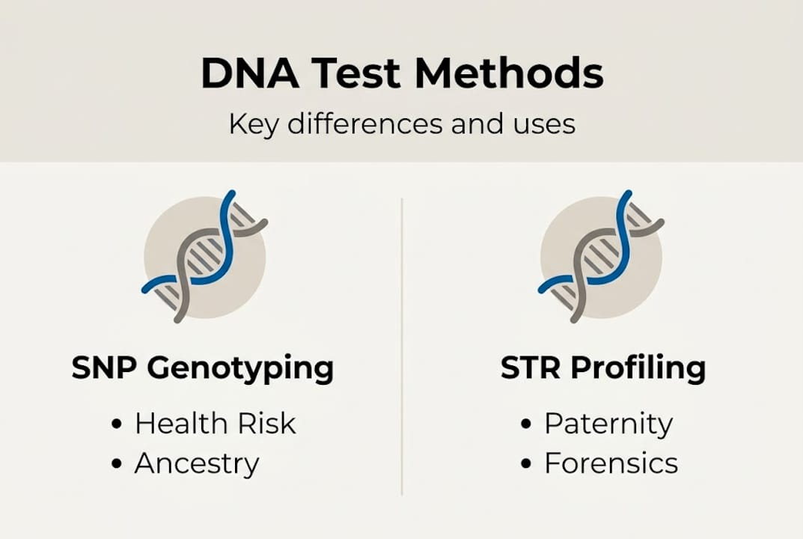
Chastain Y-DNA Project
-
Two Types of Y-DNA tests:
STR – Short Tandem Repeat – generic paternity
SNP (Snip) – Single Nucleotide Polymorphism – deep ancestry
The STR tests (Y-37 to Y-111) will determine a degree of relatedness, that a group of men share a common ancestor. But, they can not determine who that ancestor is. Markers can fluctuate between generations. Good entry level tests with upgrade options for Big Y.
The SNP test (Big Y-700) can create a genetic tree if enough men up and down a lineage test. SNP markers are stable, are passed on to succeeding generations. SNP’s can pinpoint genetic branching and via conventional genealogy can pinpoint a specific common ancestor.
The Chastain Y-DNA Project’s main emphasis is the SNP test (Big Y).

Slide 3
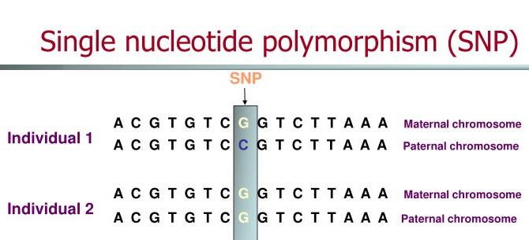

Chastain Y-DNA Project
-
SNP – Single Nucleotide Polymorphism
Sometimes a small copy error occurs where one building block chemical is substituted for another on the opposite DNA strand.
This change is then passed down to succeeding generations.
Haplogroup – A haplogroup is a SNP that has been identified in 2 or more males. Once a SNP is detected in two or more persons, it will be named as a Haplogroup, placed on the Haplotree, or genetic tree, as a branching point
Private Variant – A SNP that a tester is positive for not in common with any other person testing. Once a second person tests for this SNP it is no longer “private” and becomes a haplogroup.
SNP Path – A man just doesn’t have one Haplogroup but rather a string going back in time
Basic Y-DNA (Big Y Test) Terminology
Notes:
Discuss results of our Big Y Test – Big Y is SNP based test. STR tests (y37, y67, y111) have not been productive in regards to defining lineages, they certainly provide a degree of relatedness but they do not determine genetic lineages.

Slide 4
Chastain Y-DNA Project
-
One man will have thousands of SNPs (and haplogroups).
SNPs are inherited from one generation to the next, generation to generation, from fathers to sons along a continuous “SNP Path”.
Each SNP having formed in a different paternal ancestor.
SNP’s typically do not occur each generation, the average is 1 SNP per 2.3 generations.
When a SNP change occurs in two men of the same existing haplogroup, it marks a more recent common ancestor for them and a new genetic branch in a family.
People may share a surname but if they do not share a common SNP Path, they do not share a common male ancestor. Likewise, if two men of different surnames share a SNP Path/Haplogroup, then they share a common male ancestor.

Slide 5
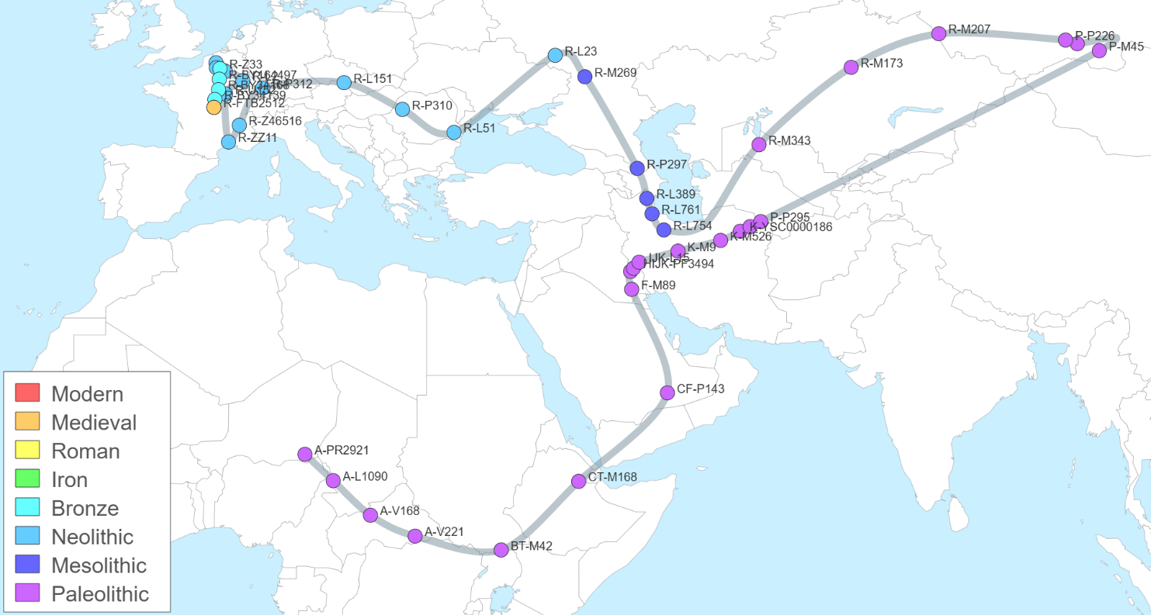
Chastain Y-DNA Project
-
SNP Path for R-FTB2512 (Pierre, Estienne) below.

Slide 6
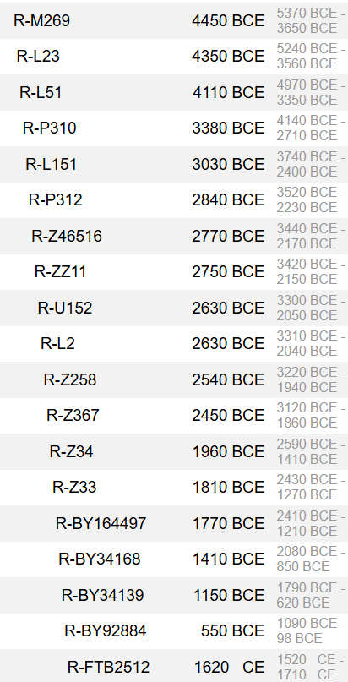
Chastain Y-DNA Project
-
SNP Path for R-FTB2512 (Pierre, Estienne) below.
Equivalents: A44, A7055, FTB2580, FTB2625, FTB2871, FTB2872, FTB3060, FTB3064, FTB3572, FTB3589, FTB3709, FTB3809, FTB3839, FTB3912, FTB4077, FTB4464, FTB45233, FTB45513, FTB4645, FTB5414, FTB54397, FTB54417, FTB54418, FTB54419, FTB54420, FTB5466, FTB5483, FTB5534, FTB5535, FTB72645, MF92098

Slide 7
Chastain Y-DNA Project
Result Interpretation, Take-Aways
-
Established a “Chastain Clade” Haplogroup, R-FTB2512, for Pierre Chastain.
Descendants of all three of Pierre’s documented sons are positive for this SNP. If you are a male descendant of Pierre Chastain you will be positive for this SNP.
Rene Chastain, Sr. can not be the antecedent of any of the assigned men to his brother Peter, Jr. Rene’s descendants are post Pierre Haplogroup R-FTC77767.
The Revolutionary War Soldier James Chasteen and his assumed brother Jesse descend from the same man, post Pierre, as George and Robert Ransom Chastain…They are genetic sons of William Chastain, R-FTB4515.
Haplogroup FTC75609 contains descendants of Rev. John Chastain. A person testing with an unknown lineage and positive for R-FTC75609 would descend from Rev. John.
Under Rev. John’s Haplogroup, descendants of 3 of Abner’s proposed sons are positive for a new SNP formed in Abner, R-FTD43063. Proving their lineage to Abner and Abner’s to Rev. John.
The Ohio Shasteen family, unfortunately, are not genetic male descendants of Pierre Chastain, their haplogroup is I-M253.
R-Y86031 is a post Pierre (FTB2512) Haplogroup shared by descendants of Abraham, Rene (Son of Peter) and assigned descendants of Rev. James (Stephen, Obadiah, etc.). Not present in William and Rev. John descendants.
Notes:
1. FTB2512 + doesn’t matter how you spell the name or if there are multiple gaps in legal records.

Slide 8
Chastain Y-DNA Project
-
R-FTB2512
The Chastain Clade Haplogroup
Originated in Pierre or Etienne, etc.
Descendants of all 3 of Pierre’s sons + for this SNP
R-FTB45915 – William Chastain Group
  George Chastain c. 1766
  Robert Ransom Chastain c. 1770
  James Chasteen (RWS) c. 1761 *
  Jesse Chasteen/Shasteen c. late 1750’s-65 *
R-FTC75609 – Rev. John Chastain Group
  Elijah Chastain descendants
  Rev. Joseph Chastain descendants
  R-FTD43063 – Abner Chastain c. 1765 **
      William Chastain c. 1785
      Abner Chastain II c. 1810-15 **
      Edward “Ned” Chastain c. 1819 **
  R-FTF20113 – Edward Brigand Chastain c.1769
      “Hootchie” John Chastain
      Edward Bruce Chastain
      Joseph Carleton Chastain
R-Y86031 – Descendants of 1) Rev. James Chastain, 2) Abraham Chastain, and 3) Rene, Son of Peter
  Obadiah Chastain c. 1785
  Absalom Chastain c. 1785 (James 1812 NC) ***
  John Chastain c. 1807
  R-FTE9604 – Rene c. 1748 “Son of Peter”
  R-FTC39394 – Stephen Chastain 1762 Group
    Royal Chastain c. 1790 SC ***
    James Chastain c. 1800 SC
    Sanford Chastain c. 1820 (James, above?)
    Allen Chastain c. 1838 (John 1790??)
R-FTC77767 – Rene Chastain, Sr. b. 1713
  Peter Chastain b. 1736
  Rev. Rene Chastain, Jr. b. 1742
* Prior to yDNA testing the lineage was unknown.
** Presumtive lineage prior to yDNA testing.
*** Lineage change due to yDNA testing.
R-Y86031 – a brother to William and Rev. John, who?
Notes:
Discuss possibilities for R-Y86031…Pierre son of Jean Adam, a Peter III son of Peter Jr.???

Slide 9
Haplogroup SNP’s applied to our current genealogy
R-FTB2512
Pierre
R-FTC77767
Rene
1713
Peter
1736
Rene
1742
Peter 1707
No SNP
Jean Adam
1790
Pierre
1728
John II
1721
R-FTB45915
William
1730's ?
R-FTC75609
Rev. John
1730's ?
Renny
1790
Martin
1768
R-FTD43063
Abner
1765
R-FTF20113
Edward Brigand
1769
No SNP
Elijah
1776
R-Y86031
Traditional Descendants of
Rev. James:
Obediah, Absalom, John 1807-10
R-FTC39394
Stephen 1762
Abraham
c1750
No SNP
R-FTE9604
Rene
(Son of Peter)
c1748
Joseph
1783
James
1761
No SNP
Jesse
1760-65
George
1766
No SNP
Robert R.
1770
Elisha 1778
Abraham, Jr. 1793
Royal 1790
James 1800
Obediah
1785
Absalom
1785-90
(James 1812)
John 1807-10
John 1783
sons:
Miles 1807
John B. 1822

Slide 10
Haplogroup SNP’s applied to our current genealogy
Everyone post Pierre, including descendants down to the present generation, is positive for R-FTB2512.
2nd Generation:
There are not enough present-day testers to determine if Jean Adam had a unique SNP.
Rene Chastain, Sr. born 1713 has a distinct marker/SNP/Haplogroup in R-FTC77767 that all his descendants carry.
It is apparent that Peter Chastain, Jr. did not have a unique marker/SNP that he passed down.
3rd Generation:
In the third generation both William (R-FTB45915) and Rev. John (R-FTC75609) have unique SNP’s handed down to their descendants.
The SNP/marker R-Y86031 is the ancestor of Rene (designated as “Son of Peter), Abraham Chastain born circa 1750, and the traditional descendants of Rev. James Chastain. Rene, Abraham, and James currently assigned as sons of Peter, Jr. But, these three men, genetically, are 4th generation men rather than 3rd. So, Y86031 is a currently unknown male in our lineages.
In Rev. John’s line, two of his four sons, whose descendants have tested, also passed on unique SNP’s to their descendants. Abner (R-FTD43063) and Edward Brigand (R-FTF20113). Since we have descendants of two sons of Elijah who did not match other than on Rev. John, it is apparent that Elijah did not have a unique SNP.
Under the Y86031 Haplogroup, descendants of Stephen Chastain (1762-1830) carry FTC39394 and descendants of Rene, Son of Peter carry FTE9604.
Remember, you have a SNP path back in time. For example, if you descend from Edward Brigand Chastain you are positive for any unmatched variants that occurred in men between you and Edward Brigand, then FTF20113 that occurred in Edward, then FTC75609 in Rev. John, and then FTB2512 that occurred in Pierre (or an ancestor of Pierre’s).
 | Unmatched Variants | Edward Brigand | Rev. John | Pierre
Present Descendant of Edward B. | R-FTX1111,R- FTX222 | R-FTF20113 | R-FTC75609 | R-FTB2512

Slide 11
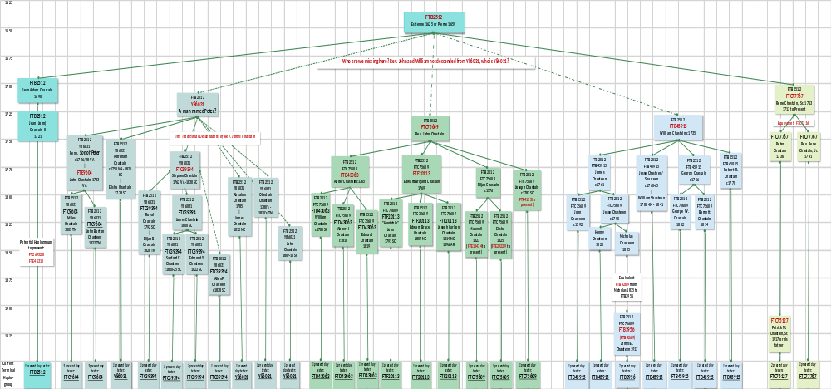
Chastain Y-DNA Project

Slide 12
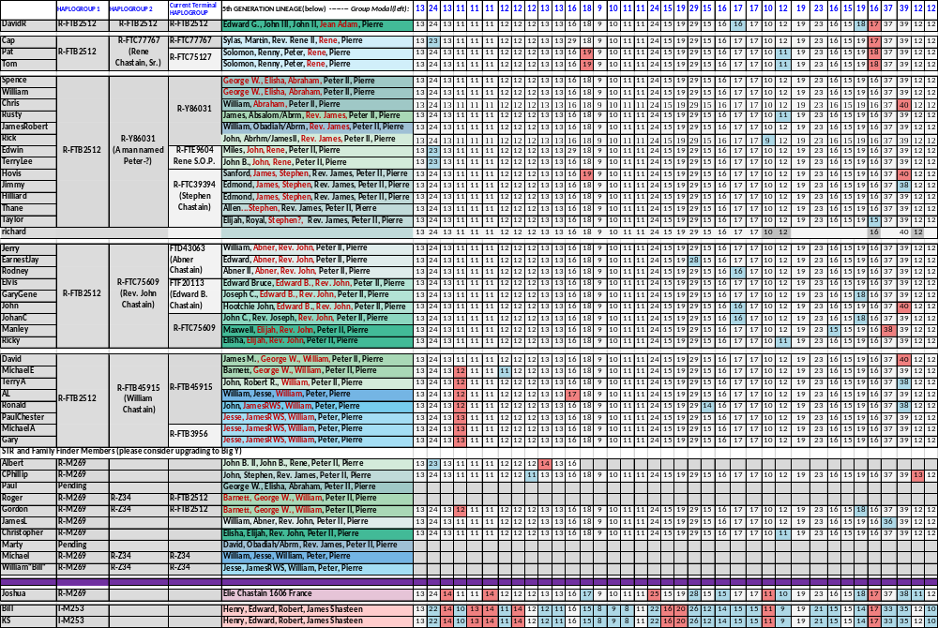
Y-DNA STR Table

Slide 13
Chastain Y-DNA Project
-
Questions and comments

